Slide 1
Analysis of Student Debt and Outcomes for Different College Types in 2017
Alexander and Satyen
April 2019

Slide 2
Summary
Each year, tens of millions of Americans make choices about higher education. They decide whether to go to college, which school to attend, the level of education, training to pursue and choice of institute type.
One of the most important decision families must grapple with is assessing which institute type (public, private for-profit or private non-profit institution) will best prepare their children to achieve their goal, as it will have lasting impact on students and their future outcomes.
Deciding which institute type to attend will lead to differences in price of attendance and could lead to differences in the amount that students have to borrow and their ability to repay.

Slide 3
Is there a difference in debt situations between graduates of for-profit schools compared to public and non-profit colleges?
Do for-profit schools leave their students with more debt upon graduation?
To answer this, we will investigate the distribution of student debt at different types of school
How soon are students able to repay their loans after graduation? Does this vary between different schools types ?
To answer this, we will investigate the rate of total repayment at different types of school
Is there a correlation between high debt on graduation and higher future earnings? How does this compare between for-profit and other schools?
To answer this, we will investigate the relationship between student debt and their earnings after graduation
Are these different types of schools the broadly similar across the whole country in terms of how much debt their students acquire?
To answer this, we will investigate how much debt students acquire at schools in different states

Slide 4
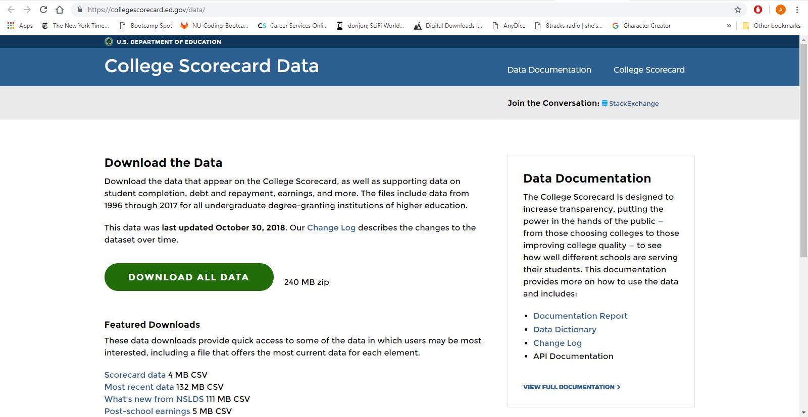
Data Cleanup & Exploration
https://collegescorecard.ed.gov/data/
https://collegescorecard.ed.gov/data/documentation/

Slide 5


Slide 6
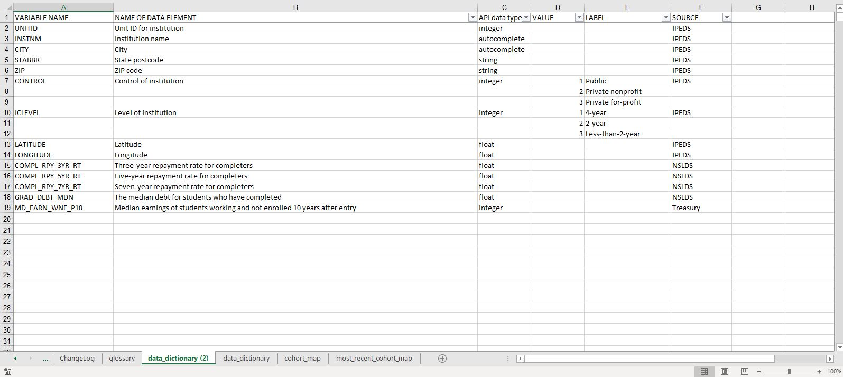
IPEDS - Integrated Postsecondary Education Data System (National Center for Education Statistics) NSLDS - National Student Loan Data System (Department of Education)

Slide 7
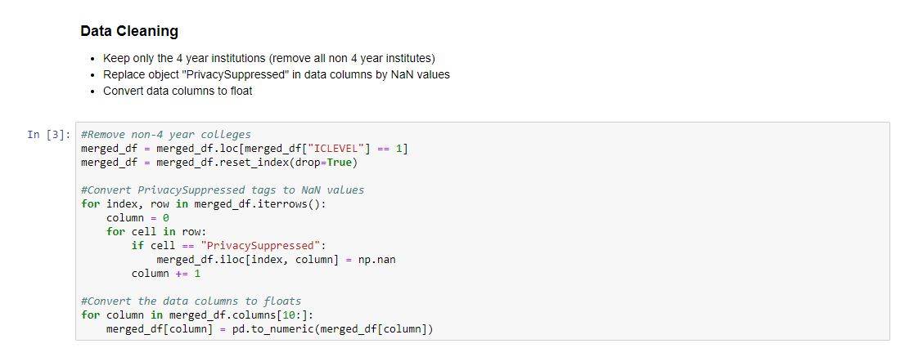
Data Cleaning

Slide 8
Data Analysis

Slide 9
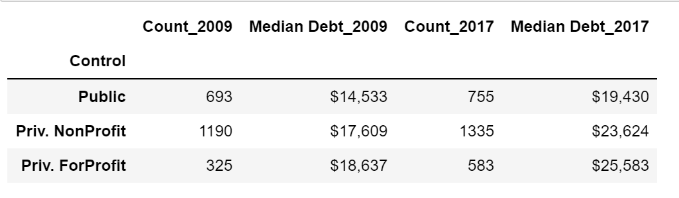
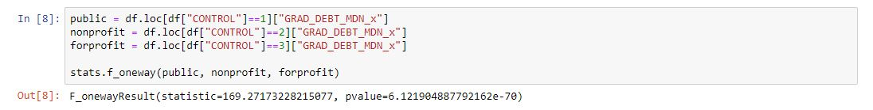
Hypothesis: There is a significant difference in median debt taken by students at private colleges and public ones
Null Hypothesis: There is not a significant difference in median debt
The p value is less than 0.05 thus we can reject the null hypothesis

Slide 10
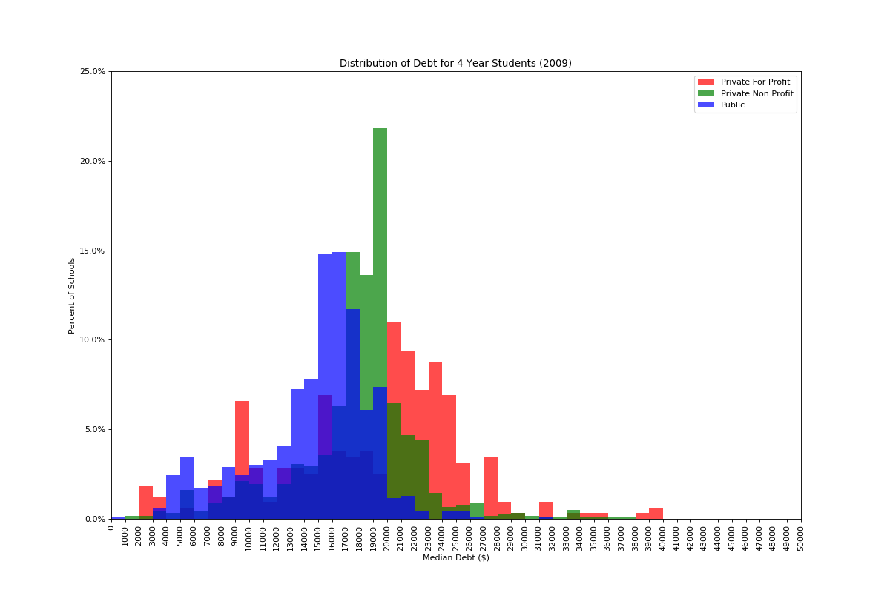
Distribution of Debt for 4 Year Students (2009)

Slide 11
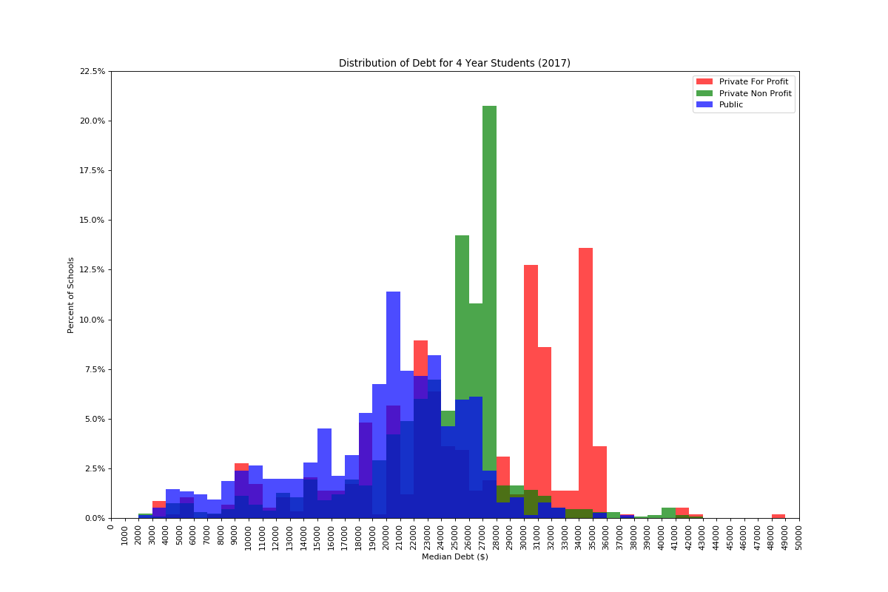
Distribution of Debt for 4 Year Students (2017)

Slide 12
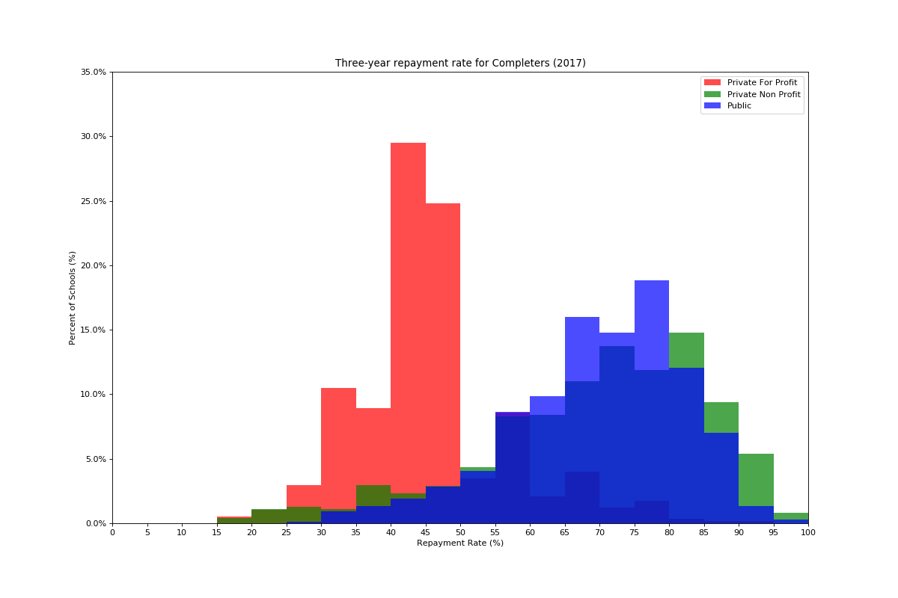
Three-year repayment rate for Completers (2017)

Slide 13
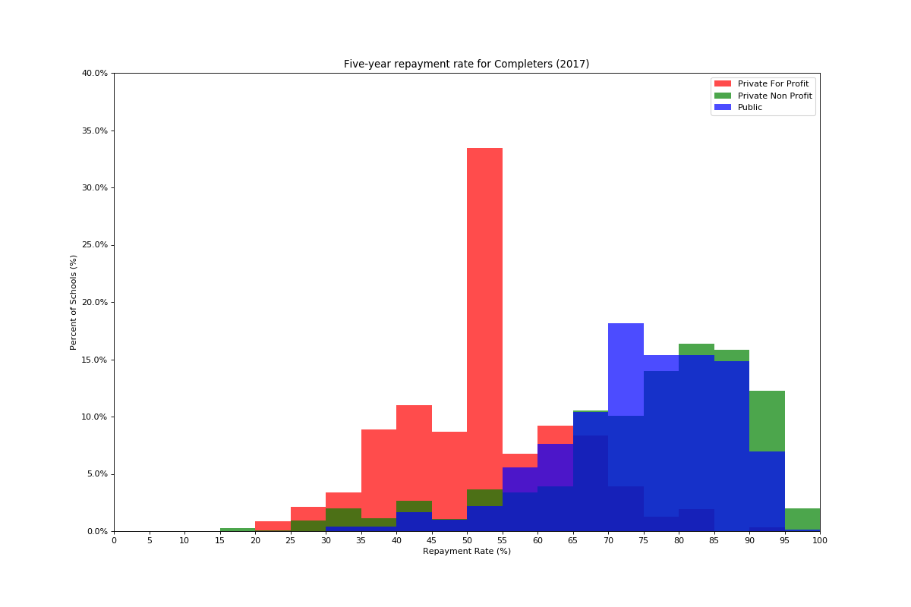
Five-year repayment rate for Completers (2017)

Slide 14
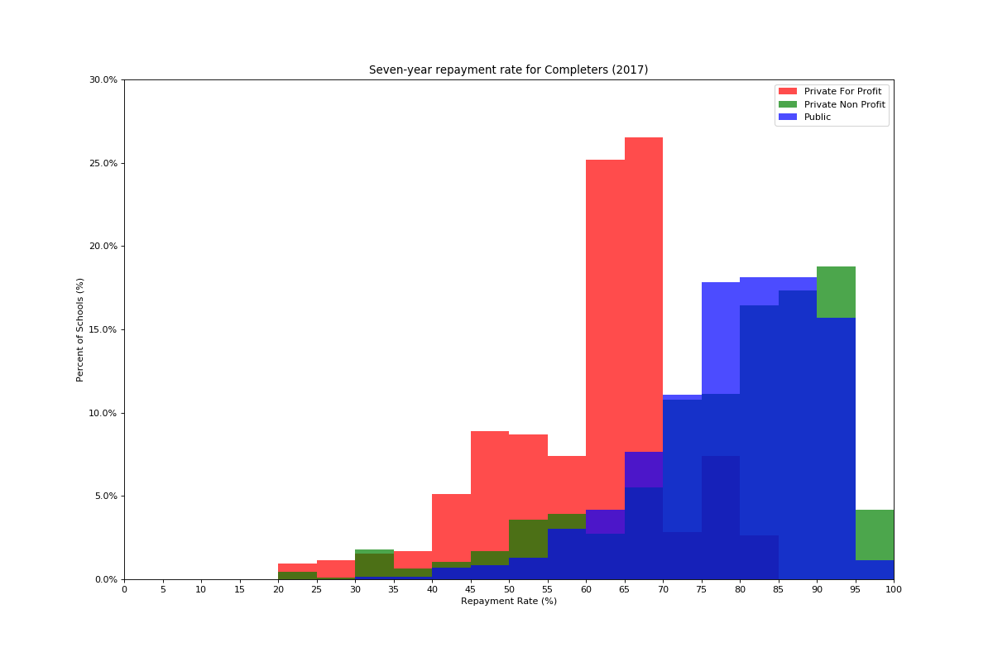
Seven-year repayment rate for Completers (2017)

Slide 15
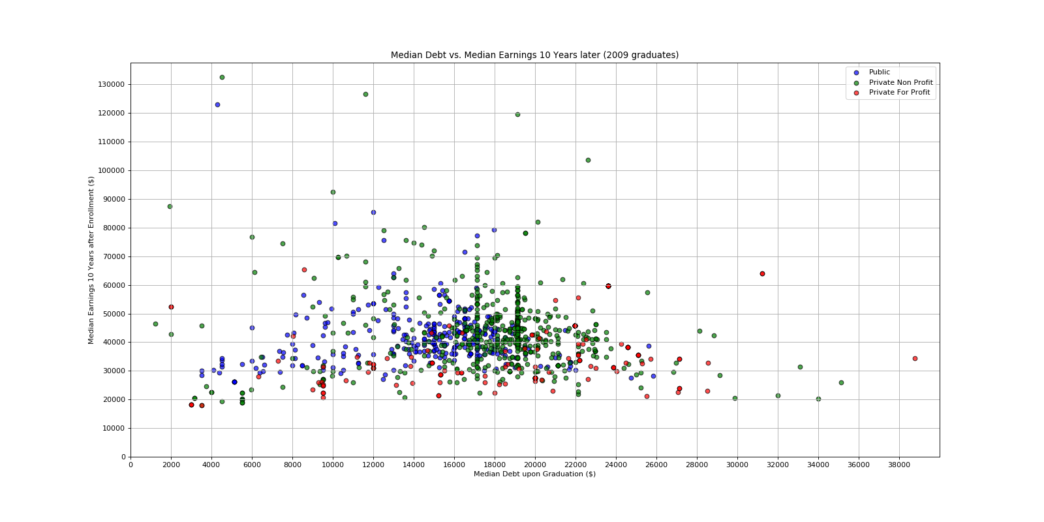
Median Debt vs. Median Earnings 10 Years later (2009 graduates)

Slide 16
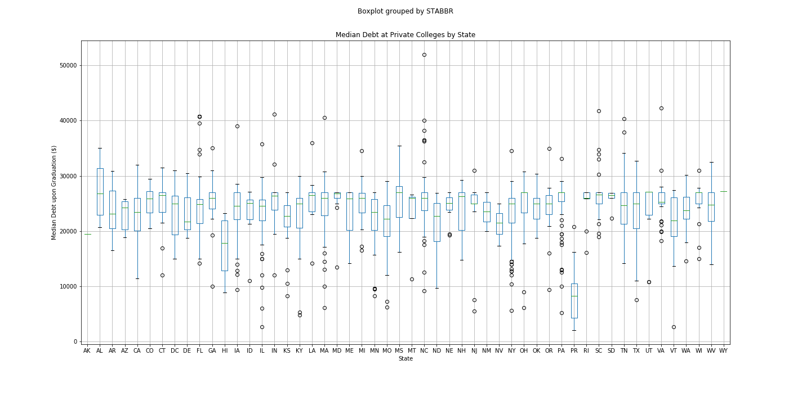
Median Debt at Private College by State

Slide 17
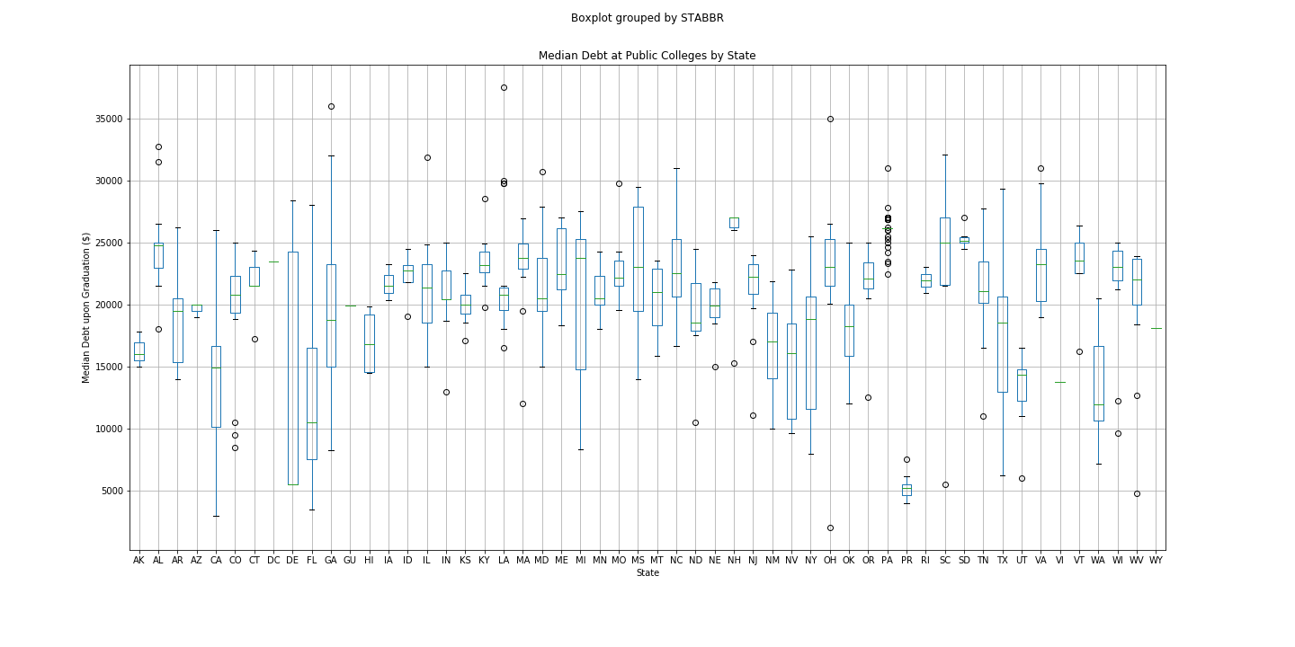
Median Debt at Public College by State

Slide 18
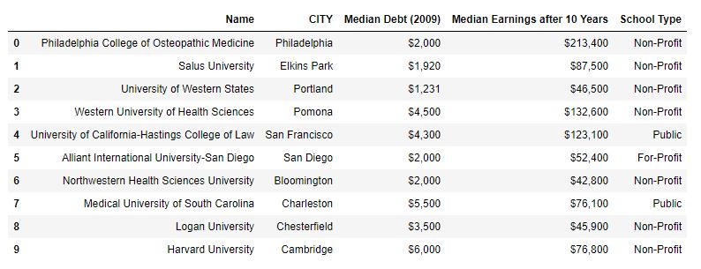
Post Mortem

Slide 19
